Slide 1
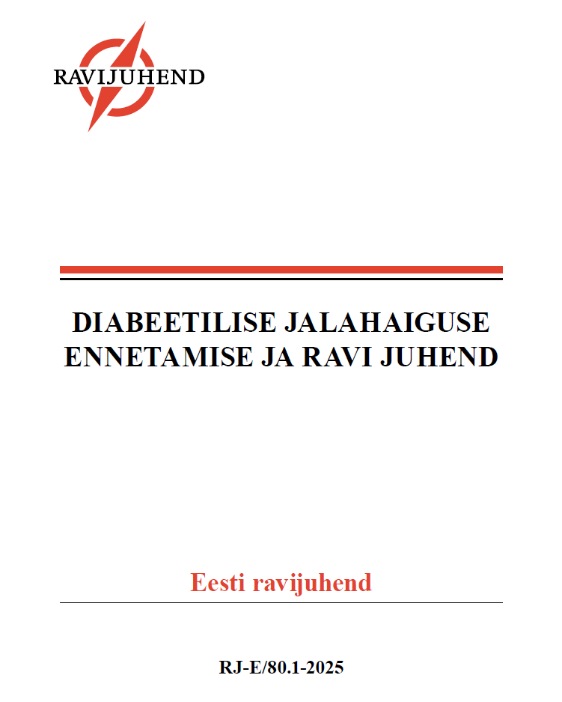

Slide 2
DIABEETIKU JALATÜSISTUSED
Neuropaatia
Perifeerne arterihaigus
57%
Diabeetiku jalatüsistused
Haavand
Charcot artropaatia
Infektsioon
Jala amputatsioon
Vaegurlus
Elukvaliteedi langus
Suremus
Tervishoiu maksumus
Edmonds, M., et al. (2021). "The current burden of diabetic foot disease." J Clin Orthop Trauma 17: 88–93.
Notes:
Diabeetiliste jalatüsistuste peamised riskifaktorid on labajala kaitsetundlikkuse kadu, perifeerne arterihaigus ja labajala moone (10). Euroopas esineb eespool mainitud tegureid IWGDF-i riskikategooriate alusel hinnatuna 56,9% diabeetikutel (4).

Slide 3
Eestikeelse Juhendi vajalikkus
Diabeedi levimus suureneb → jalatüsistuste levimus suureneb
Diabeedi jalatüsistuste ravile võib kuluda 1/3 diabeedi ravirahast
Rahvusvahelised juhendid (IWGDF)
Puudus Eesti oludele kohandatud omakeelne juhend

Slide 4
Eestikeelse juhendi vajalikkus
Hoiab diabeetikute jalatüsistuste ravi fookuses
Eestis jalahaavandiga diabeetikuid 4200-7500
Välditavad amputatsioonid
Tervishoiukorralduslik aspekt
Tervishoiuteenuste hinnakiri
Ortooside kättesaadavuse parandamine
Ravivõrgustiku loomine (haiglas multidistsiplinaarne meeskond, perearstid, jalakabinetid, ortoosifirmad)
(Diabeedi jalatüsistuse e-konsultatsioon)
Juhised, mida tüsistuse puhul ette võtta

Slide 5
sihtrühm
Diabeetikutega tegelevad arstid ja õed/eriõed
Peremeditsiinis
Erakorralises meditsiinis
Endokrinoloogias
Haavaravis
Koduõed
Füsioterapeudid

Slide 6
käsitlusala
Üle 18 aastased T1 ja T2 diabeetikud
Käsitleb
Ei käsitle
Ennetus
Sõelumine
Nõustamine
Diagnostika
Neuropaatia, verevarustus, naha seisund, riskitegurid
Ravi korraldus
Integreeritud jalaravi
Diabeet üldisemalt
Diabeedi muud tüsistused
Muud jalahaavandid
Haavandite kirurgiline ravi
Notes:
Sõelumine = jälgimine: haavandumise riskikategooria määramine ja sellest tulenev jägimise intervall
Nõustamine: millist infot jälgimise käigus patsiendile jagada

Slide 7
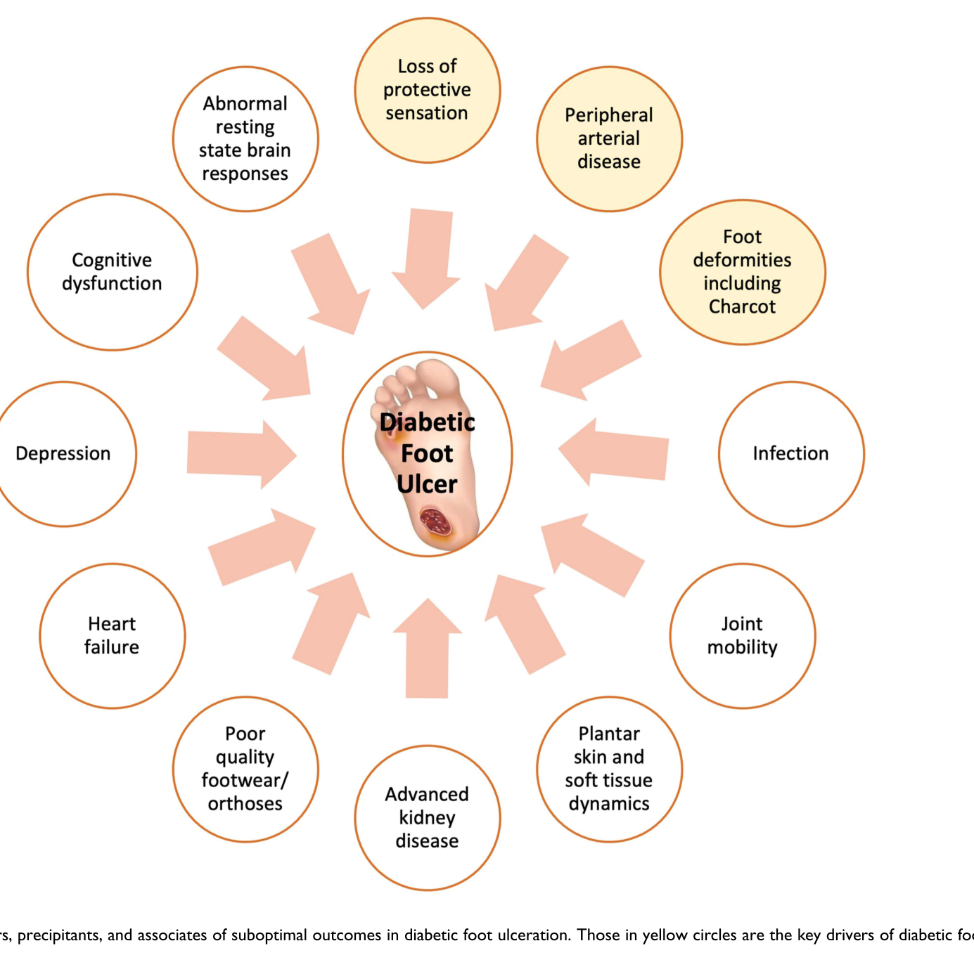
HAAVANDI RISKITEGURID
Vas, P. and N. Chockalingam (2023). "Improving Physical, Physiological, and Psychological Health Outcomes in Patients with Diabetic Foot Ulcers - State of the Art." Clin Cosmet Investig Dermatol 16: 3547–3560.
Notes:
It is vital to acknowledge that DFU represents a complex setting, where several risk factors coexist and continuously interact within the same individual.
Therefore, it is perhaps not surprising that anxiety and depression are present at levels consistent with clinical depression in patients with DFU.52,53 In a community setting, the presence of depression may double the risk of new DFU in an individual with no history of diabetic foot problems.54 Nearly half of all individuals with DFU attending hospital-based clinics may meet the criteria for depression.55,56 In addition to increasing the risk of incident DFU,54,57 depression has also been shown to be associated with a two-fold increased risk of mortality during or after treatment for DFU.55 An increasing body of evidence suggests that abnormal cognitive function is prevalent in longstanding diabetes.
Diabetes increases the risk of developing cognitive dysfunction which may progress to cognitive impairment.58,59 A decline in cognitive function may be manifested as diabetes self-care neglect, inability to follow through with recommendations and increased use of care resources.59 The risk factors associated with such cognitive decline60 are the same cluster that drives vascular complications, diabetic neuropathy and indeed depression. This signifies that the processes that underpin the development of these individually distinctive complications may be interlinked.60,61 Of note, these are also the same risk factors for diabetic foot ulceration. More recently, the presence of cognitive dysfunction complicating DFD has been recognised. In one study, while the premorbid cognitive abilities among diabetes individuals with and without DFU were estimated to be similar, the cognitive abilities of individuals with ongoing DFU were found to be significantly lower in all domains tested (memory, attention, executive function, reaction time and psychomotor skills)

Slide 8
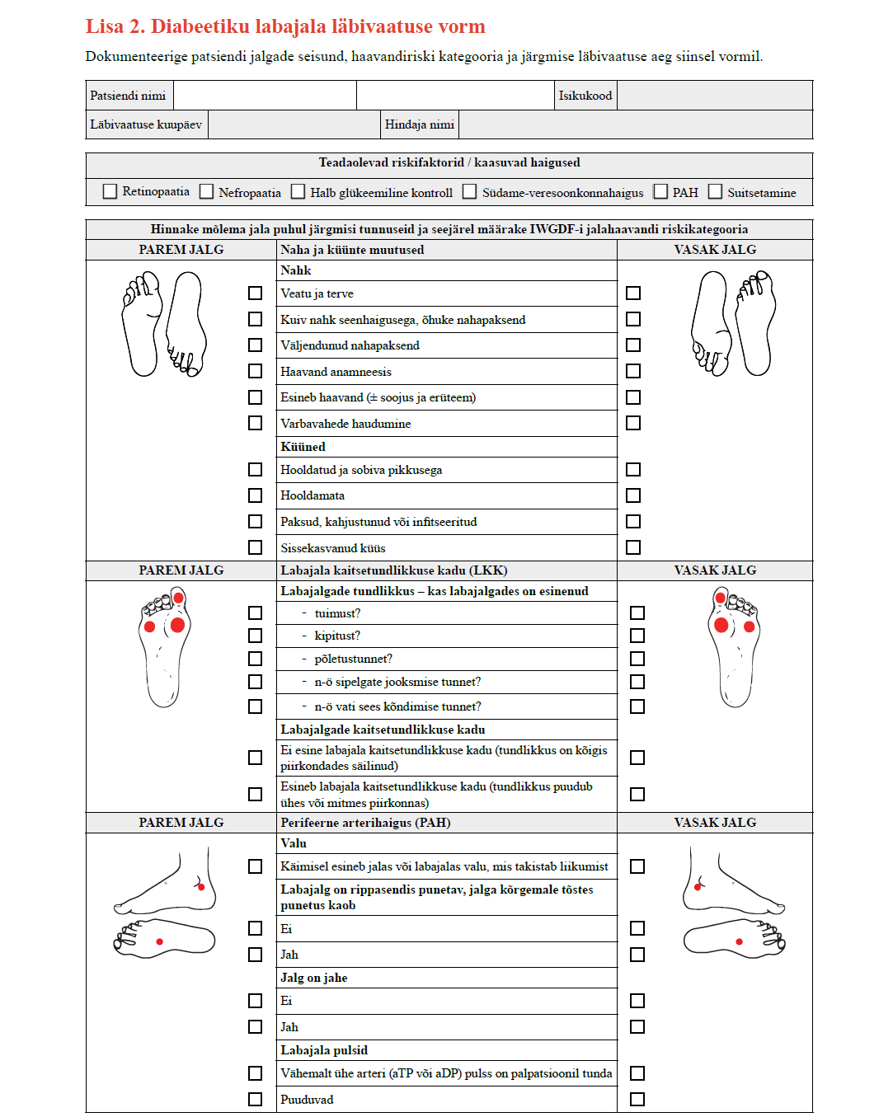
PALUN VAADAKE VASTUVÕTUL DIABEETIKU JALGU

Slide 9
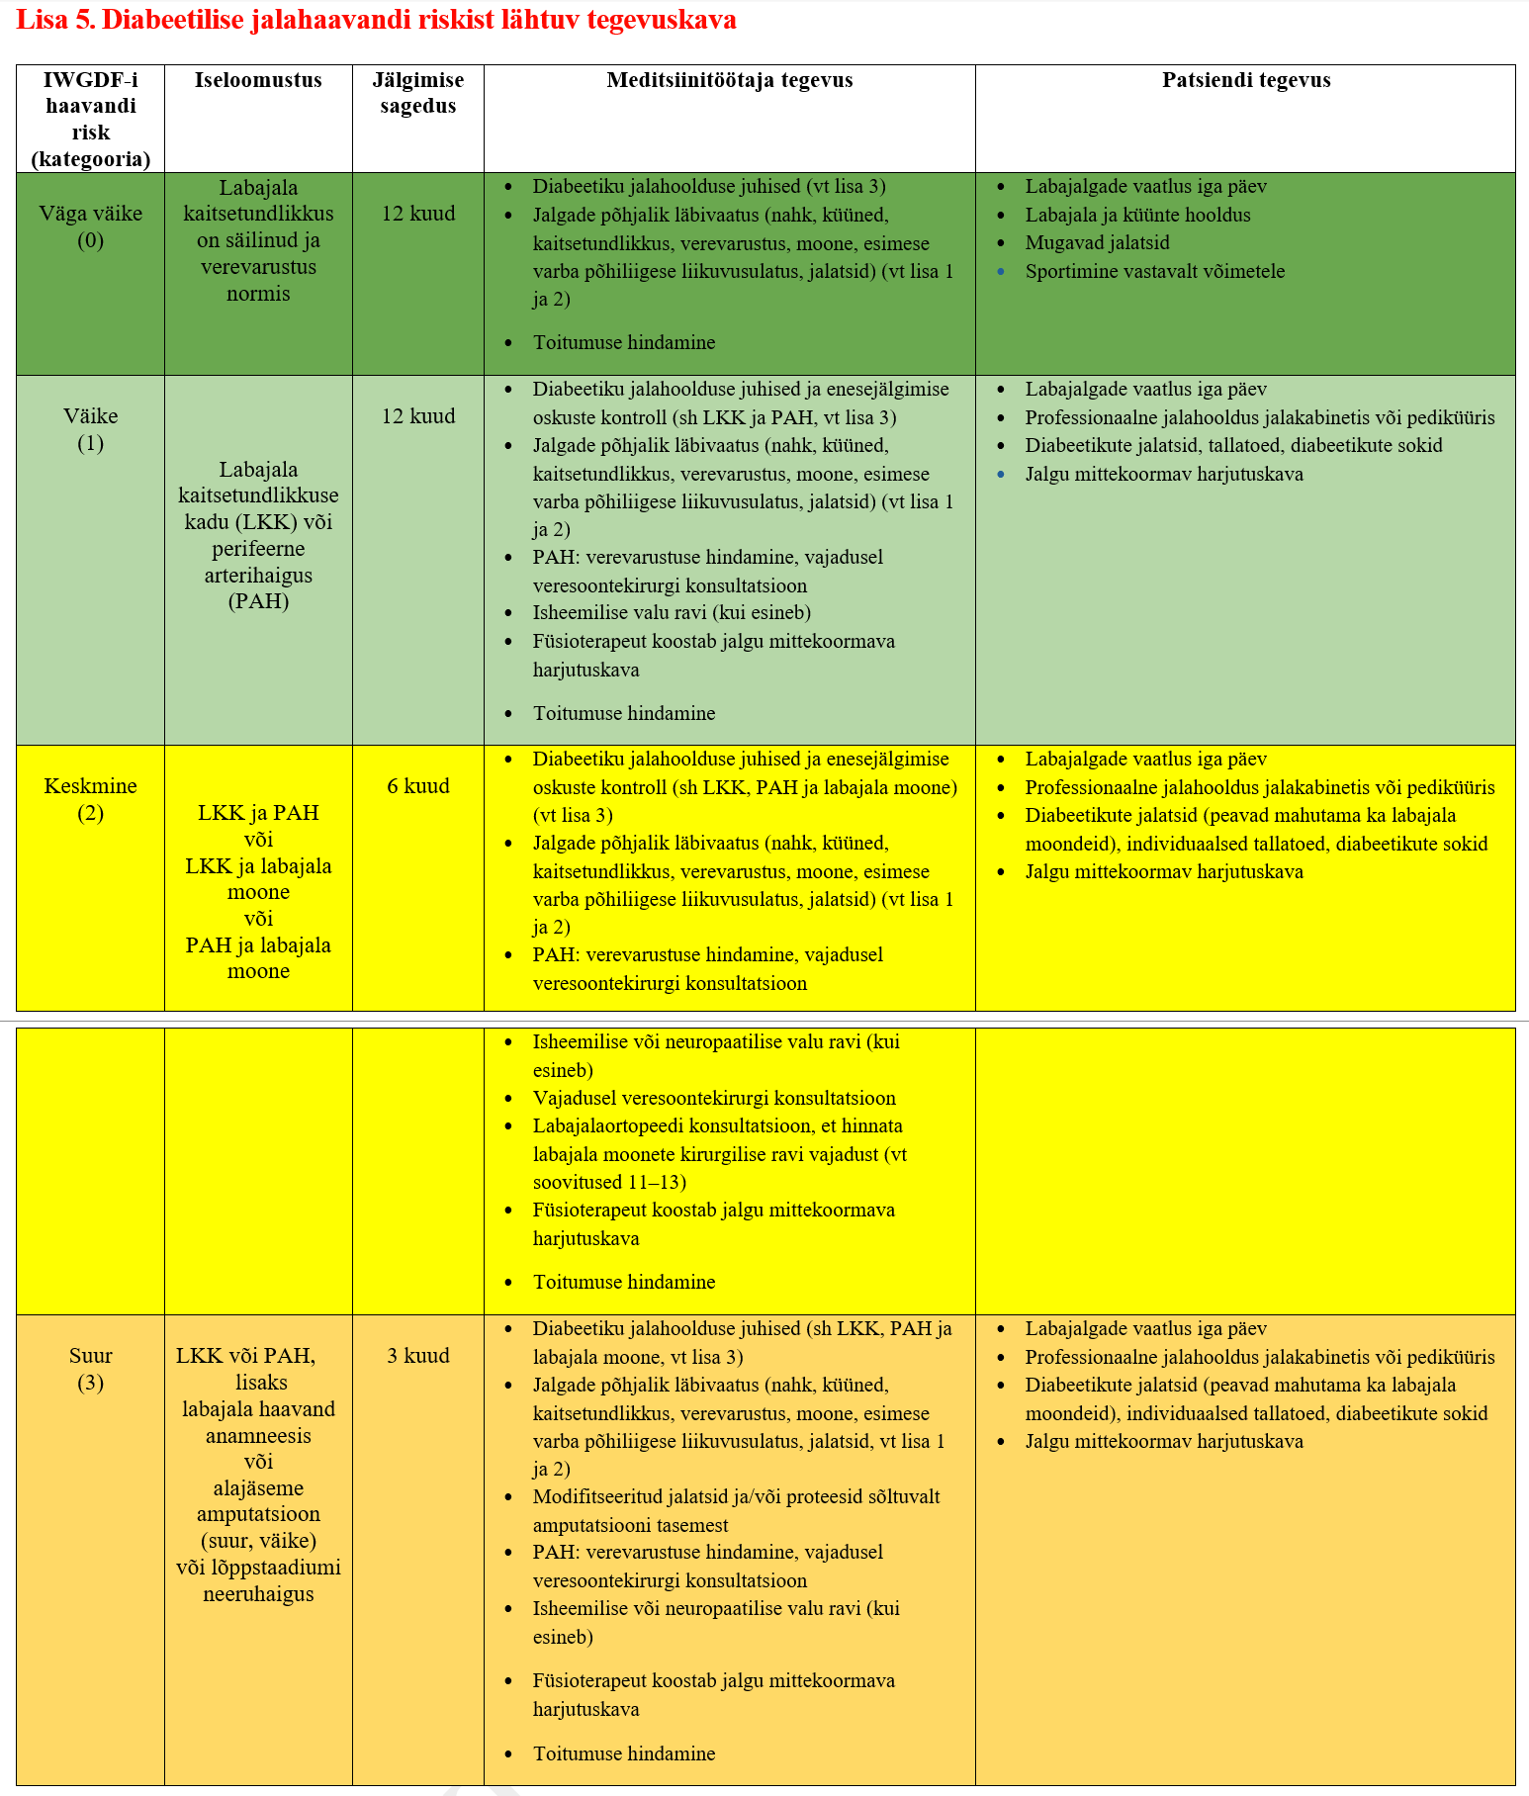
DIABEETIKU SKRIINING
Notes:
Haavandiga patsient vajab selget raviplaani

Slide 10
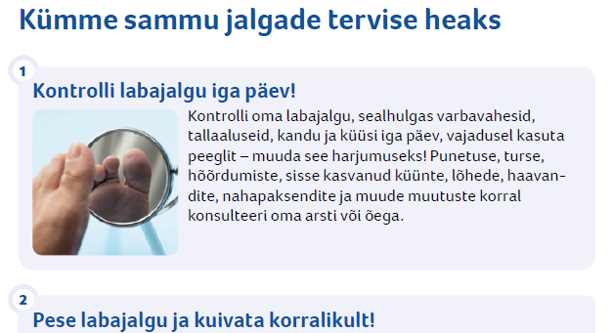
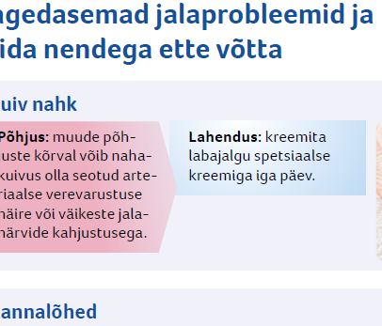
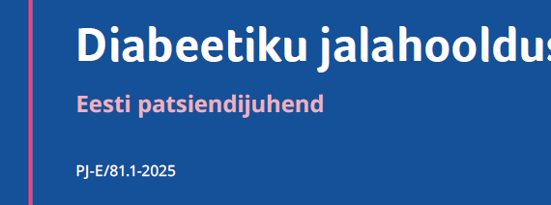
DIABEETIKU NÕUSTAMINE

Slide 11
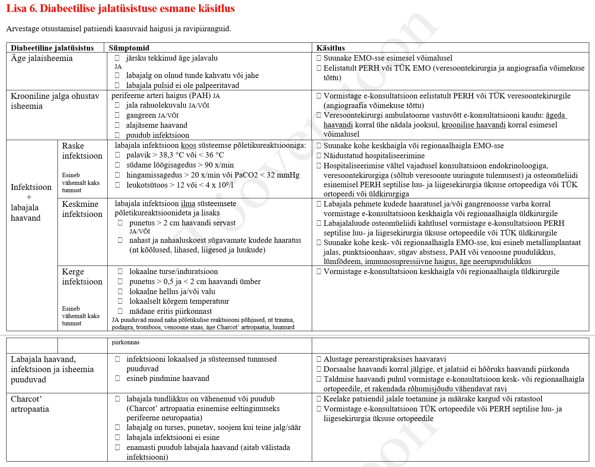
JALATÜSISTUSE KÄSITLUS

Slide 12
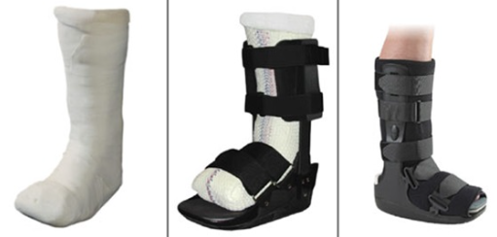
TALDMINE HAAVAND CHARCOT ARTROPAATIA
Koormuse langetamine
Notes:
Haavandi puhul ei piisa ainult lokaalsest ravist.
Koormuse langetamine, verevarustuse hindamine.

Slide 13
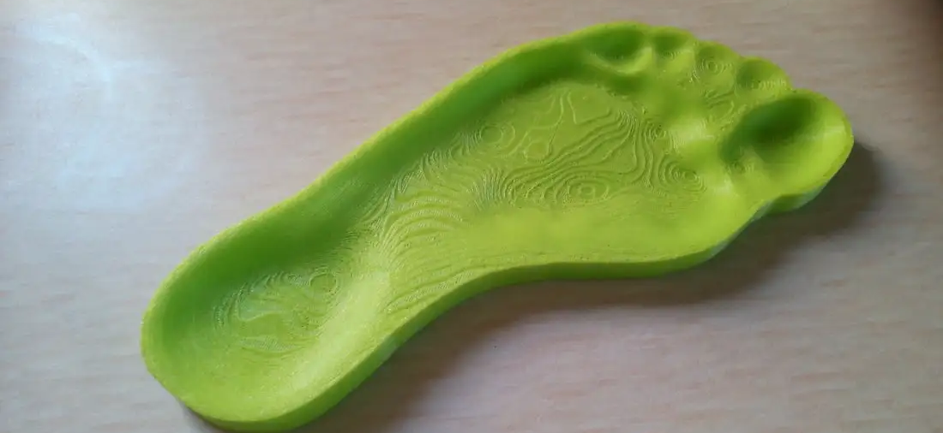
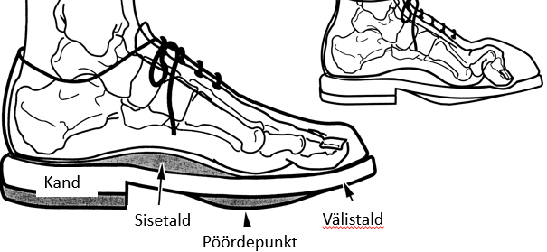
PARANENUD HAAVAND MOONDUNUD JALG
Jalatsid
Tallatoed

Slide 14
RAVIKVALITEEDI MÕÕDIKUD
Haavandi-vabad päevad
Haigla-vabad päevad
Tegevusrohked päevad
Ulcer-free, hospital-free and activity-rich days: three key metrics for the diabetic foot in remission. Khan, T. & Armstrong, D.G. J Wound Care 2018 Issue Sup4 Pages S3-S4

